Slide 1
Graph Database
neo4j
Shreyas Kalrao 33255
Someshwar Gaikwad 33256
Sushant Sontakke 33257
Yash Rathi 33262

Slide 2
Introduction
A graph database (GDB) is a database that uses graph structures for semantic queries with nodes, edges, and properties to represent and store data.
Graph databases are a type of NoSQL database, created to address the limitations of relational databases.
Storage Mechanism: Logical Table, Key-Valued or Document-Oriented Database.
Retrieving data requires a query language other than SQL: like Gremlin, SPARQL, Cypher (Also APIs Available)
Graph databases employ nodes, properties, and edges.

Slide 3
Why Use Them? Advantages over RDMS
Most Important Difference: Nodes directly joined, Finding Related Data-> Follow Connections, whereas use Join-> more complex; Hence very fast response time
Property: Index-Free Adjacency, Fast Queries (millions of nodes per second)
Flexibility of a graph database->add new nodes and relationships without compromising your existing network. (Scalability)

Slide 4
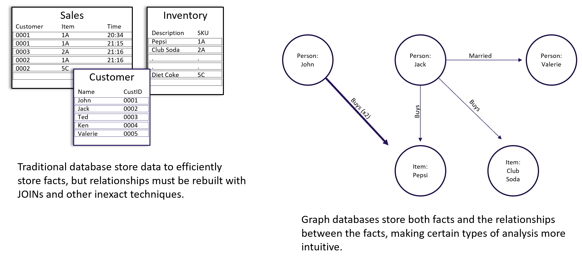

Slide 5
What can go Wrong?
Technology is Fairy New whereas RDBMS have been existing for generations
On paper Graph Database sounds Powerful, but it is of no use if we are not able to implement them.
Though it uses a Graph Structure, the underlying structure is that of a traditional table

Slide 6
Characteristics
Performance: They have superior performance for querying related data, big or small. A native graph has the so-called index-free adjacency property, where each vertex maintains its neighbor vertices information only, no global index about vertex connections exists.
Better Problem Solving: Graph databases solve problems that are both impractical and practical for relational queries. Examples include iterative algorithms such as PageRank, gradient descent, and other data mining and machine learning algorithms.
AI Infrastructure: Graph databases serve as great AI infrastructure due to well-structured relational information between entities, which allows one to further infer indirect facts and knowledge. Machine learning experts love them

Slide 7
Characteristics Continued…
Storage: The underlying storage mechanism of graph databases can vary. Some depend on a relational engine and “store” the graph data in
a table .Others use a key-value store or document-oriented
database for storage, making them inherently NoSQL structures
Index-Free Adjacency: Data lookup performance is dependent on the access speed from one particular node to another. Because index-free adjacency enforces the nodes to have direct physical RAM addresses and physically point to other adjacent nodes, it results in a fast retrieval.

Slide 8
Features of Neo4j
Cypher, a declarative query language similar to SQL, but optimized for graphs. Now used by other databases like SAP HANA Graph and Redis graph via the openCypher project.
Constant time traversals in big graphs for both depth and breadth due to efficient representation of nodes and relationships. Enables scale-up to billions of nodes on moderate hardware.
Flexible property graph schema that can adapt over time, making it possible to materialize and add new relationships later to shortcut and speed up the domain data when the business needs change.
Drivers for popular programming languages, including Java, JavaScript, .NET, Python, and many more.

Slide 9
Performance
The more connected your data is, and the more complex your query is, the faster graph technology is at processing your requests.
With no need to translate requests into non-graph methods or syntax, Neo4j delivers fast, accurate results for even complex queries of connected graph data.
Relational approaches are appropriate for tabular data with static schemas, but not for the demands of highly connected or changing datasets.
Index-free adjacency to traverse millions of data records with sub-second response times, even when those queries mine data several layers deep.
Graph databases are designed to traverse stored data very quickly and retrieve results in milliseconds.
Exceed performance expectations when traversing relationships among data for data science and analytics purposes where decision making is required.

Slide 10
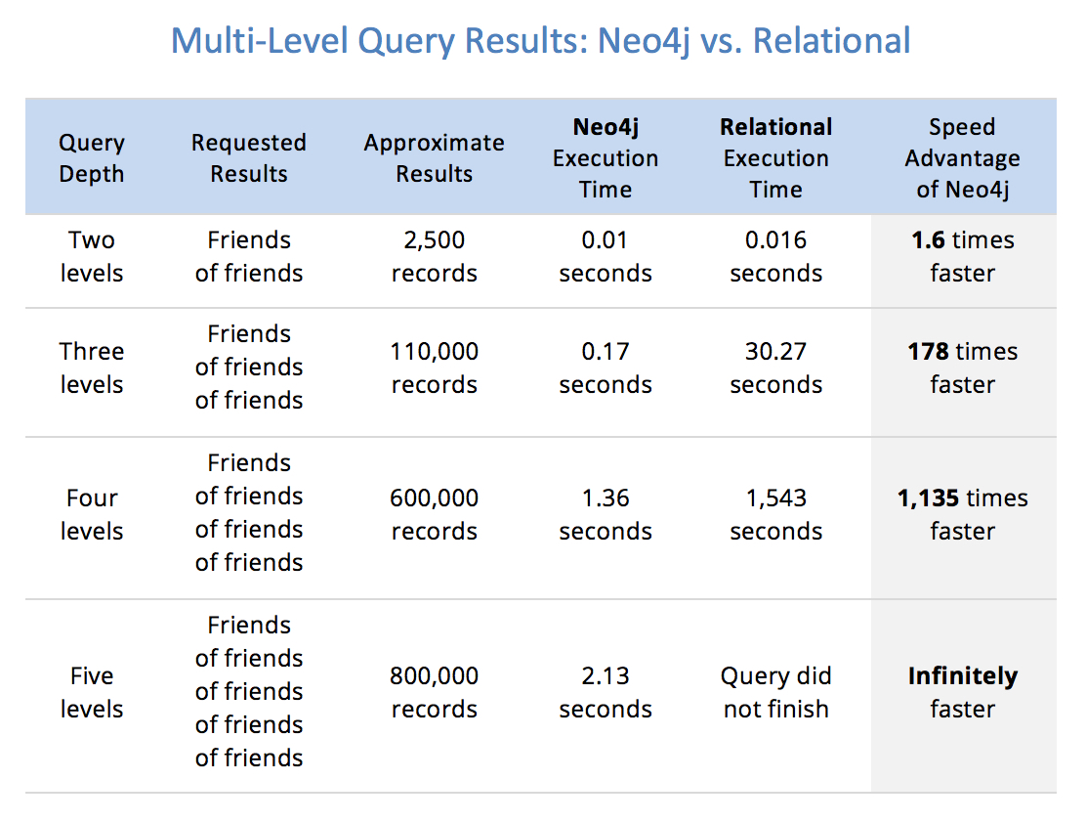

Slide 11
Applications Continued…
The Neo4j graph database platform can be used for a wide variety of business applications, but there are many for which native graph technology is absolutely required to meet performance and reliability requirements. Some samples of those applications appear below.
Retail and E-Commerce (eg : Walmart, fortune 50)
  Purchase history recommendations
  Peer recommendations
Social and Business Networks (eg : LinkedIn, gamesys)
  Friendship and relationship sites
  Professional networks and organizations
  Event recommendation and review sites
  Membership and organization management\
Information Management
  Identity and access management
  Master data management
  Network operations
  Internet of Things and sensor monitoring
  Support case solution

Slide 12
Applications Continued…
Customer and Sales Management (eg : eBay, medium.com)
  Prospect identification
  Product recommendation
Finance (eg : Citi Bank, UBS bank, Global 50 bank)
  Identity and access management
  Fraud detection
  Product and service recommendations
Healthcare (eg : Novartis)
  Care provider recommendations
  Clinical data analysis and bioinformatics
  Insurance fraud
Logistics (eg : Transparency One, Volvo, Caterpillar, Airbus)
  Real-time routing
  Supply-chain management and risk assessment

Slide 13
Installation of Neo4j
Download
First, download a copy of Neo4j from the Neo4j download page. You can choose from either a free Enterprise Trial, or the free Community Edition.
This tutorial uses the Community Edition.
To download, simply click the Download button. Your download should start automatically.
Installation
Once the file has downloaded, you can install Neo4j.
The download screen includes step by step instructions on installing Neo4j on to your operating system.

Slide 14
Windows(exe)
Launch the installer you just downloaded. You might have to give the installer permission to make changes to your computer.
Follow the prompts, and choose the option to Run Neo4j.
Click on the Start button to start the Neo4j server.
Open the provided URL in your local web browser.
Change the password for the neo4j account.

Slide 15
Linux/UNIX Install (tar)
Open up your terminal/shell.
Extract the contents of the archive, using: tar -xf <filecode>.
For example,
tar -xf neo4j-enterprise-2.3.1-unix.tar.gz the top level directory is referred to as NEO4J_HOME
Run Neo4j using $NEO4J_HOME/bin/neo4j console. Instead of ‘neo4j console’, you can use neo4j start to start the server process in the background.
Visit http://localhost:7474 in your web browser.
Change the password for the neo4j account.

Slide 16
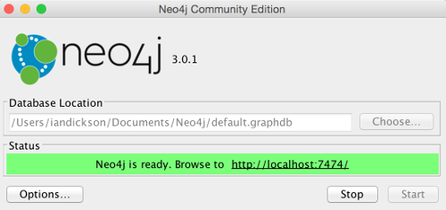
Starting and Connecting to the Neo4j
1.Start the Server
The installation instructions include instructions for starting the Neo4j server. The exact method you use will depend on your operating system.
For example, on a Mac, clicking Neo4j Community Edition from the Applications folder will launch this screen that allows you to start the Neo4j server.
Once the server has been started, open the following URL in your web browser: http://localhost:7474/ and follow the prompts.
Below are the screens I encountered when logging in for the first time (note that future versions may be different).

Slide 17
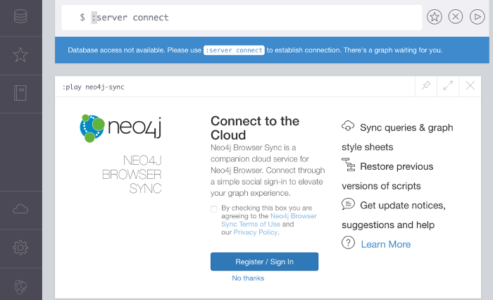
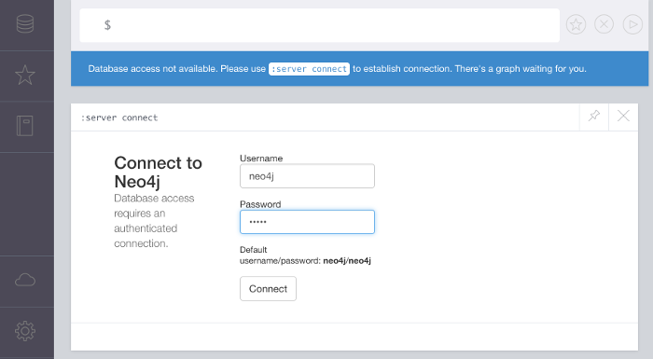
2.Connect to Neo4j
You can either create an account for the cloud service or click No thanks
Log in using the username and password provided on
the screen.
The first time you log in you will be prompted to change your password.
3.Log In

Slide 18
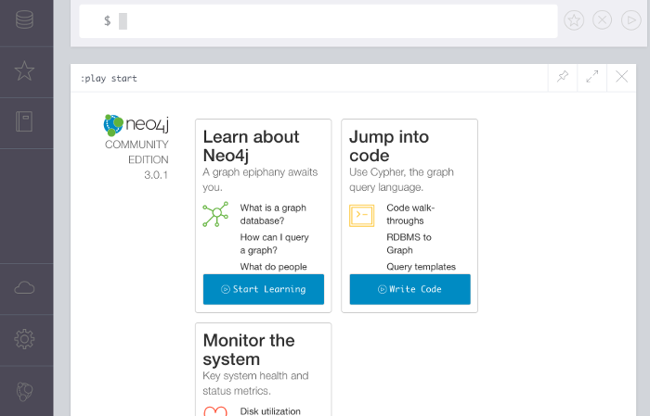
4.The Result
Once the password has been changed, this screen is displayed.
Here, you can use the links to learn more about Neo4j and how to create databases and run queries.

Slide 19

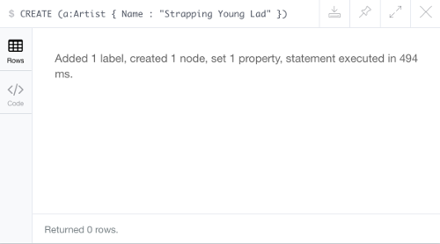
Operations in Neo4j
Neo4j has its own query language called Cypher. Cypher uses a similar syntax to SQL (Structured Query Language).
To create nodes and relationships using Cypher, use the CREATE statement.
Creating a Node:
CREATE (a:Artist { Name : "Strapping Young Lad" })
Once Neo4j has created the node, you should see a message like this:

Slide 20
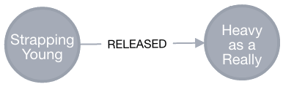
Displaying the Node
CREATE (b:Album { Name : "Heavy as a Really Heavy Thing", Released : "1995" })
RETURN b
The CREATE statement creates the node but it doesn't display the node.
To display the node, you need to follow it up with a RETURN statement.
Creating Relation between Nodes
MATCH (a:Artist),(b:Album)
WHERE a.Name = "Strapping Young Lad" AND b.Name = "Heavy as a Really Heavy Thing"
CREATE (a)-[r:RELEASED]->(b)
RETURN r
It creates the following relationship:

Slide 21
References
https://en.wikipedia.org/wiki/Graph_database
https://neo4j.com/news/relational-vs-graph-databases/
https://sdtimes.com/databases/guest-view-relational-vs-graph-databases-use/
https://neo4j.com/blog/why-graph-databases-are-the-future/
https://towardsdatascience.com/graph-databases-whats-the-big-deal-ec310b1bc0ed
https://neo4j.com/blog/why-graph-databases-are-the-future/
https://neo4j.com/customers/?ref=home
https://en.wikipedia.org/wiki/Neo4j

